Slide 1
Welcome to the Webinar on Online Communication and Counselling with Youth
Presenter: Gayle Browne | Moderator: Shalini Lal
March 12th, 2020

Slide 2
WEBINAR INSPIRATION

Slide 3
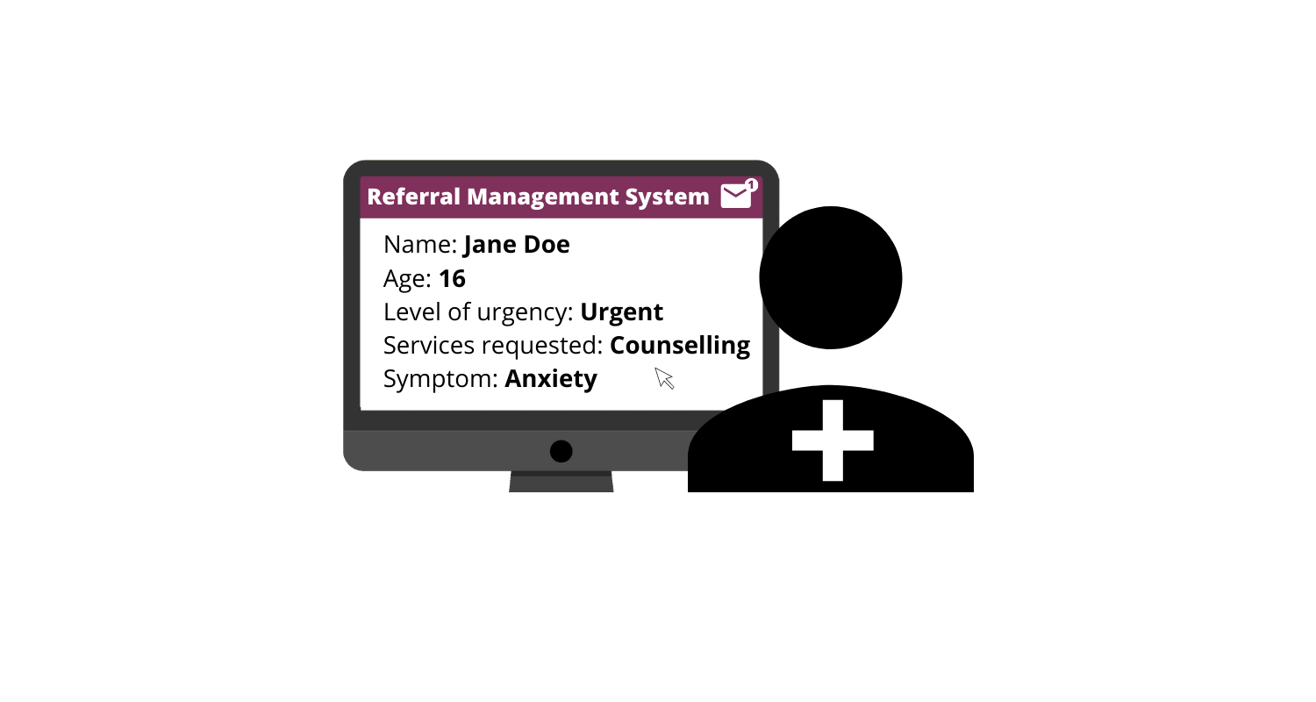
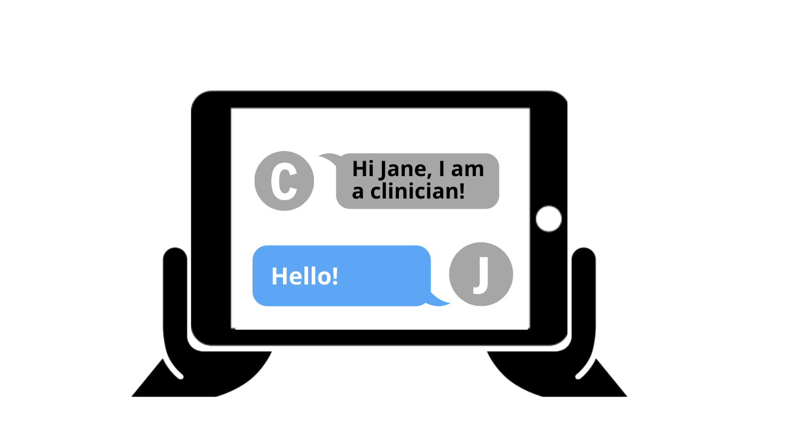
Pathway for Rapid, Internet-based, Self-referral to Mental health services for youth
Parcours d’autoréférence Rapide, via Internet, aux services en Santé Mentale jeunesse
Objective: Develop and pilot-test the use of an online self-referral pathway to facilitate rapid referral, referral management, and direct access to mental health services for youth.

Slide 4
Technology can be used to...
Improve access to mental health services
Communicate and engage with youth during their initial stages of seeking mental health services
Importance of education and training on the factors to consider when communicating with youth online

Slide 5
Introduction of Today’s Presenter
Gayle Browne
Manager of Training and Education
at Kids Help Phone

Slide 6
Online Communication and Counselling with Youth
October 2019

Slide 7
Learning Goals
Insight into why reaching clients online is beneficial
Identify the unique challenges of digital communication in supporting clients
Learn to communicate empathy and warmth electronically
Consider language usage in online communication as it relates to tone and professionalism
Learn to repair ruptures and build rapport
Review possible session endings and next steps

Slide 8
Online support is able to reach young people who:
For various reasons choose to communicate through more informal means
Do not live in close proximity to their mental health services
Attempt to seek formal mental health services, but face barriers such as lack of access, lack of transportation, caregiver attitudes, and culturally based stigma
Are already connected to mental health services but are struggling to cope between appointments
Have acute problems that require more support than is available through formal mental health systems and the people in their immediate communities
Are not experiencing mental health concerns, but rather require help and support to face more typical challenges of everyday living experienced by most young people
May have hearing loss and find communication by text easier
Are seeking privacy and don’t want to be overheard by others in the home

Slide 9
Communicating and Counselling Online
Supporting clients without being able to see them or hear them is challenging and it takes time to hone the required skills.
It requires us to pay even closer attention, because we only have one way to receive information about the client.
It also requires us to be curious, and ask for specific information and details that are not always communicated through text.
Experience with face to face and telephone support will help you in your online counselling, as you will be familiar with having fewer ways to gather information.

Slide 10
Beginnings

Slide 11
Information Gathering
body language, knowing who the person is, community knowledge, identifying information, multiple sessions possible, time to build therapeutic relationship
tone of voice, pacing, breathing rate, background noise
words, vocabulary, emojis, pacing, level of engagement
Notes:
Green circle: all of the ways info is sent and received between people face to face
Blue circle: over the phone
Purple circle: online

Slide 12
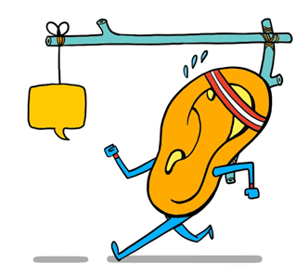
Attention/Attentiveness
Attentiveness is the state of being awake, alert, and actively paying attention
It is observing not just what clients say, but how they say it.
What are some elements we can be attentive to during an online session?
spelling, capitalization, punctuation, vocabulary, username, gender, cultural identity, language skills, mood, emoticons, maturity…
During an online session, it can be easy for clients (and counsellors) to become distracted…
How do we encourage clients to remain attentive during a session?
How do we remain attentive?
© Claud Li, 2019
Notes:
Discuss questions as a group
Talk about distractions on both sides
https://www.imagethink.net/listen-up/

Slide 13
Lack of Contextual Clues
It can be helpful to deliberately inquire about things that may inform the situation, such as identity considerations.
Online counselling forces us to be more curious and ask more questions – this can often help the client gain deeper insight.
I wonder… is there anything else you think would be helpful for me to know about you, or your family, that is influencing this problem?
Hmm… A lot of times, our parents’ experiences or values can influence how they respond to a mental health problem. Do you think this is an issue in your situation?
Notes:
We know it takes longer to develop rapport, gather information, and form an accurate impression of the situation in online than on the phone… but this also saves us making assumptions!!!
What are some other ways that you can ask about things like culture, religion, language, background, family, environment, etc. What kinds of information is going to be important for you to understand the context?

Slide 14
Curious Questions we can ask…
I want to be careful not to make assumptions about you as we talk about relationships. Is there anything you want me to know about how you identify that might influence this issue?
If you had the chance to describe yourself to a person who wanted to truly understand you, how would you describe yourself?
Tell me more about your family… is there anything you would like me to know about your relationships or what happens at home that would help me understand what’s going on?
I’m curious if you think there is anything else I should know about this situation and the people involved that might help me to understand?
Notes:
What other kinds of questions can we ask…

Slide 15
Language

Slide 16
Ambiguous Tone
One of the ways that we live in our own transference is when we project tone onto a seemingly neutral statement.
Our clients are often in an emotional and vulnerable place, and much more likely to project negatively onto our statements.
Notes:
Anyone who has ever read an email has had the experience of trying to figure out, “What did they mean by that?”
Tone is anyone’s guess in emails and because our brains are more likely to fire along pathways that are wired more strongly, we likely associated these sentences with strong emotions in our own lives.
Used to praise and safety – a positive interpretation
Used to criticism, experiencing stress and worry – a negative spin.
Transference: unconscious transferring of experiences from one interpersonal situation to another. Like a rerun of past feelings that exist in the person’s unconscious
Countertransference: the emotions evoked in the counsellor by the client’s transference projections. To recognise countertransference reactions when a counsellor says something that does not correspond with their typical personality.

Slide 17
Ambiguous Tone
How would you read the following statements:
I really like your outfit. Where did you get it?
I want to do my homework later.
We want take out for dinner.
I can’t believe you did that.
Those statements are neutral, but could all be read as:
positive, neutral, or negative.
It is easy to put a meaning to different statements, depending on current emotions or past experiences.
Notes:
Have counsellors read statements out loud, attaching their own tone to them. Discuss if others would’ve read them differently.

Slide 18
How do we Clarify Tone?
Be transparent about why you are asking certain questions (ex risk assessment)
Remain curious, ask about things we don’t understand
Use emotional bracketing [I know it sounds strange, but we will talk about this more later]
Check your work- reread what you’ve written before pressing enter
Acknowledge when you’ve missed something or made a mistake, it could be an opportunity to build rapport
☺ ☹
Notes:
Articles for further reading… https://www.psychologytoday.com/blog/threat-management/201311/dont-type-me-email-and-emotions OR https://www.fastcodesign.com/3036748/why-its-so-hard-to-detect-emotion-in-emails-and-texts
Emojis- not all will be visible or the same on your end and the clients end

Slide 19
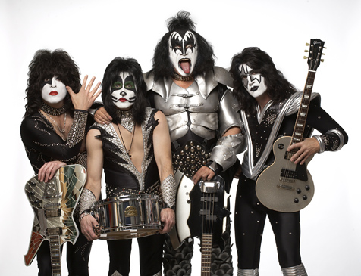
Style Points: Simple, Succinct and Sincere
Tailor your language to your client, refer to forms/paperwork for their own wording and descriptors
Be mindful of different reading and writing skills
Use your empathy <3
Try to ask questions one, maybe two at a time
Use simpler words, phrases when possible
Think about how you can translate your voice and tone
K.I.S.S. (Keep It Simple Suzie)
Notes:
Use only one or two phrases per sentence
Use adjectives and adverbs sparingly and deliberately
When in doubt, use the simpler, shorter phrase

Slide 20
Paragraph Challenge
“So, just listening to you…I’m wondering…You know you mentioned some stuff about kinda, like, maybe wanting your grandmother to be more involved in your life. Like on a day-to-day basis… Do you think that’s something she knows about- how you feel about her not being in your life so much in the past and asking her? Is that something you would consider thinking about doing?”
Possibly: Does your grandmother know you want her in your life? What would it be like to talk to her about that?
Notes:
How would you edit this conversational and relaxed paragraph? Take a few minutes to think about this, and we’ll discuss…

Slide 21
Keeping Communication Professional
be mindful of correct spelling, capitalization and punctuation
create a warm, conversational tone [I know you can do it]
avoid being “too familiar”, do not use pet names (honey, sweetie) for clients
be mindful of your use of slang
Use the conversation transcript to your advantage… it’s okay to go back to re-read something, or to copy/paste something the client said to clarify or highlight change.
“At the start of our conversation, you said the thoughts were ‘off the charts intensity, an 11 out of 10!!!!!!’. I’m curious, where are you now on that same chart?”
Notes:
Be transparent about any typing errors- can build rapport. We’re not expecting perfection, but we need to come across as professionals.
Or if it’s taking you some time to respond, be transparent. Young people know that adults may not be the speediest typers… or it may be a chance to let them know you’re reflecting on what they’ve said, or really trying to understand their situation.

Slide 22
Acronyms, Slang and ☺
SMH, IDK, KMS, LOL, IMHO, TYT, BTW, OMG, TL;DR, YOLO…
ng?
gucci, wheeling, trash panda, salty, mansplain, sip tea
And emoticons?
☹ 😶 :D :-/ :$ :O
*\o/* 5:-) <3 </3 >< ¯\_(ツ)_/¯
Notes:
Ask about how counsellors would clarify meanings of acronyms/slang emoticons
(Shaking My Head, I Don’t Know, Kill My Self, Laughing Out Loud, In My Humble Opinion, Take Your Time, By The Way, Oh My Gosh, Too Long; Didn’t Read)
Slang: awesome or really good/ the stage between flirting and dating/ raccoon/ annoyed, bitter or upset/ to explain something to someone, typically a man to a woman, in a manner regarded as condescending or patronizing/mind your own business
Emoticons: Happy, sad, face without a mouth (silence)*, laughing/big grin, skeptical, embarrassed, surprised, cheering, Elvis, heart, broken heart, Smiling Face With Open Mouth & Closed Eyes OR CRINGE?
*Represents silence, as this emoji is always silent. Imagine the things this person would say if they had a mouth!
It’s okay to look these up, but clarifying with the client is also a good way to find out meaning.

Slide 23
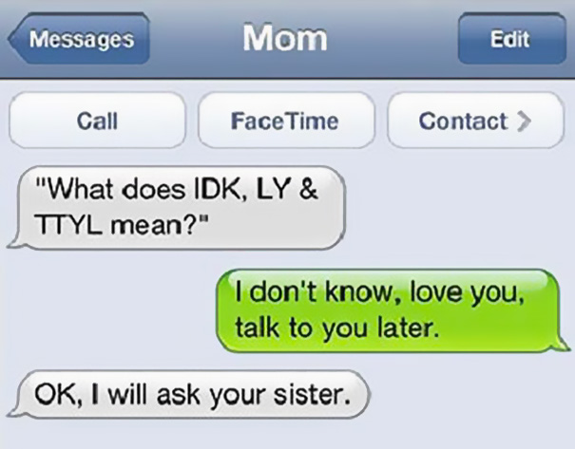
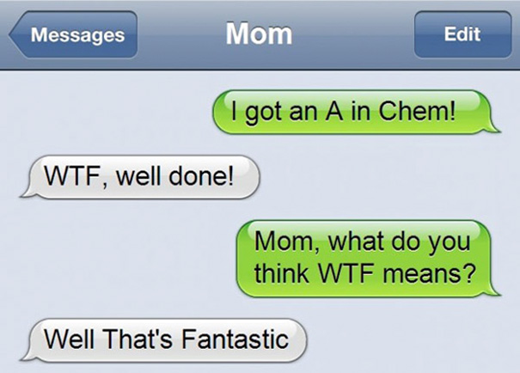

Slide 24
Warmth

Slide 25
Warmth
The Easy Part:
Warmth is a positive response actively conveyed to a client. It is usually conveyed through body language, facial expressions, tone of voice, and what you say.
The Difficult Part:
It is difficult to articulate emotional nuance through text
We have to be mindful to deliberately communicate warmth
Neutral statements are very likely to be interpreted as negative
Notes:
Warmth probably comes very naturally to you…

Slide 26
Example of Warmth
day1: And I just want someone to tell me something encouraging in order to sleep without stressing out
Counsellor: Ahh! It’s true that the first day of school is always a little stressful.
Counsellor (cont’d): I hear you :)
Counsellor (cont’d): Tell me, what is stressing you out the most at the thought of going back to school?
day1: its the fact that I am changing locations that has me lost and confused
Counsellor: Hmm.
day1: and also the fact that I don’t have my best friend with me
Counsellor: Ahh.
Counsellor (cont’d): What would help you be less stressed out, in your opinion?
day1: I don’t know…. comforting words, advice for the first day of school…. :(
Counsellor: Can you think about the last time that you were stressed out about the first day of school and everything went ok? :)
Notes:
* Talk about importance of usernames *

Slide 27
Conveying Warmth
Acknowledge the emotions presented by the client.
Without acknowledging emotions, neutral statements may be interpreted as cold, curt, or irritated
Type out vocalizations the client would have heard if it was an in-person session. “Ahh! I see…” “hmmm…”
Use appropriate emoticons to communicate what they may see on your face if they were with you ☹ ☺
Notes:
Talk about difference in emoticons depending on platform used

Slide 28
Empathy & Genuineness

Slide 29
Empathy is…
the experience of understanding a client’s situation from their perspective- putting ourselves in their shoes while maintaining professionalism
the primary way we communicate a stance of non-judgment
must be communicated deliberately
Ah, okay… tell me more about what happened…I want to understand what it was like for you…
Hmmm…I can imagine that would’ve been frustrating to have tried talking with her, only to have her ignore you…
So I’m curious, what do you think you will do next?
Notes:
It is good practice reflect feelings and address emotion when you get the opportunity…
Insert example of addressing/acknowledging emotions

Slide 30
How Do We Convey Empathy Through Text?
By taking time to paraphrase, and reflect back parts of the conversation to demonstrate our understanding, just as we do on the phones…
By making explicit in our conversation certain aspects of non-verbal communication.
Explicitly written non-verbal vocalizations (mhmms and ahas)
Short sentence fragments (conversational, inviting, ending with …)
Emoticons (highlight that we are in sync with the emotional content)
Emotional Bracketing which directly describes our empathic response inside of square brackets.
[I am feeling your doubts but we’ll have lots of time to practice]
Notes:
If we do not make empathic responses explicit the client will not feel it and worse might even find the interaction cold or curt.
Non- verbal vocalizations express a wide variety of feelings in a more casual and emotion based way. Think about “Ewwwwww” or “UGH!”
Sentence fragments ending in “…” is inviting and shows the counsellor is attempting to understand and clarify
Chat is very black and white so if you have emotional content use it!
Paraphrasing in the client’s words is what active listening might look like if typed out.

Slide 31
Examples of Emotional Bracketing
To communicate empathic feelings:
“I think you are both brave and smart to try that idea! [feeling a sense of pride in you as I read that.]”
“I am so impressed with how well you know yourself, and how well you were able to express what you’re feeling! [goosebumps]
“So knowing that she may not be interested anymore, what do you think you will do now? [I know that's a heavy question, wondering what you'll say…]”
To explain body language:
“[leaning forward in my chair] I hope you can tell me more about what that was like for you.”
“[nodding] That does sounds hard…”
To add nuance and depth to emotions:
“You’ve described a very complex and dangerous situation. [If you could see me, you would see a look of deep concern, but also hope, in my eyes.]”
“…[empathy in my eyes and a warm smile.]”
To inject humour or personality:
“I can imagine your reaction when she did that! [my jaw is on the floor!]”
“You have more good news? I can’t wait to hear it! [eyes wide with excitement]”
Notes:
Lawrence Murphy and Dan Mitchell of Worldwide Therapy Online http://www.therapyonline.ca/

Slide 32
Genuineness
Adolescents and young adults are extremely sensitive to adults’ communication being ‘‘real’’
Being genuine means being authentic in our interactions with our online clients
It’s okay to share our emotional reactions to our clients’ experiences, without using self disclosure
What may feel genuine to one counsellor may feel forced or fake to another
What are ways to express genuineness considering our own style and personality?
Notes:
What I say out loud/What I’m communicating/How to say it in digitally…

Slide 33
Trustworthiness

Slide 34
Trustworthiness
Trust is between the client and the counsellor, as well as with the agency as a whole.
How do we build trust?
Present ourselves as professional, using language as our main tool
Giving honest accurate information, providing psychoeducation as needed
Provide appropriate, trusted resources when asked
Not making promises about what will happen, using tentative language
We might only have a few opportunities to build this trust, so we need to be mindful of even small ruptures and deal with them right away…
Notes:
Honest info about what may or may not happen, especially when referring to outside agencies. We need to be extra careful and clear about information we are relaying, making sure we are not promising or implying things we simply cannot know or control. For example the limits or therapy or involving child protection services etc.
Imp to remember this around identifying info - making it clear from the beginning that if they give identifying info and there are safety concerns that our duty to report is triggered.
Poor grammar does not convey trust in the counsellor as a reliable source of trustworthy information.
Non-judgment: When hearing about abusive relationships and not vilifying the perp. Or when someone is describing their own dangerous/criminal/unsafe behavior staying with them. Being careful not to convey disapproval (remember that clients will project onto seemingly neutral responses.
Reactions aside ☺
Exercises pages 45-48

Slide 35
Relationships and Ruptures
Ruptures are common in the counselling relationship, especially online due to the ambiguity of text-to-text communication
Both clients and clinicians can contribute to ruptures, either directly or indirectly
What we want to do is learn to recognize these ruptures, and take steps to repair the relationship during the session

Slide 36
Ruptures- Indirect
When there is a problem in the therapeutic relationship, the client may communicate this indirectly, rather than naming the issue.
Clients are self blaming or self critical:
“I tried making friends and it never works.” or “I can’t do anything right”
Clients respond in an acquiescent manner: “I guess” or “kay” or “yeah” or “sure”
Clients give short, non-elaborative responses to open-ended questions: “idk”
Clients’ responses become more sporadic or non existent…

Slide 37
Ruptures- Direct
Rarely, clients will be direct with the counsellor about the problem with the relationship…
Client strongly refuses or states they feel uncomfortable with a counsellor’s intervention:
“I won’t call 911 or go to the hospital.” or “I hate CAS, why can’t I just talk to you?”
Client is sarcastic or caustic towards the counsellor:
“You’re the counsellor, you should know how to help me!” or “thanks for nothing!”
CONVERSATION TERMINATED

Slide 38
Our Contribution in Ruptures
As clinicians and human beings we sometimes miss cues and information which can lead us to misunderstand the client’s perspective…
Clinician intellectualizes client’s concerns:
“I guess we can’t expect our parents to react perfectly all the time.”
“So why not just think about that you might have some classes together? Try to stay positive!”
Clinician fails to focus on client’s concerns:
“Well, it sounds like your parents have some pretty good reasons why you shouldn’t go to that party tonight. I think it’s best to follow what they say.”
“Keep eating healthy food and it’s okay to cheat every now and again. It doesn’t mean you’ll get fat.”
Notes:
If handled with care ruptures can contribute to rapport.

Slide 39
Repairing Ruptures
Be Transparent
Acknowledge your role, did you miss something
Ask to start fresh
Ask for clarification
Ask for a check-in
Go back to being curious
Address emotion
Notes:
** Check-in with yourself, am I being triggered? **

Slide 40
Endings

Slide 41
Preparing for the End of Session
Clients may or may not feel ready to disengage, we want to be gentle and purposeful about moving into the end of a session.
Transition statements
Check-ins
Scaling questions revisited
Notes:
Counsellors should gently prepare clients for the end of counselling sessions and move into a summary phase of the conversation at an appropriate moment. The end of the session should not feel sudden or abrupt. Clients should be made aware that a Counselling session is coming to an end whenever possible and be given some time to prepare. The timing should not cut off any essential stages or components of the counselling session or extend the conversation well beyond the point of clinical value.

Slide 42
Summary of Session
Engage in a brief summary of what was discussed in the session when possible and appropriate.
Invite reflection on insights or important points that the client might take away from the session.
Genuine compliments and appreciation can end the session on an encouraging note.
I have to say, I am so impressed by your openness to try new strategies, you really showed me that tonight!
Notes:
Whenever possible, counsellors should try to engage in a brief summary of what has been discussed in the session. They should invite clients to reflect on any new insights or important points they might take away from the conversation. It’s important that Counsellors express their appreciation for clients and try to end counselling sessions on a positive and encouraging note.

Slide 43
Review of Next Steps
Some conversations will end with a review of any action plan or possible next steps. It can be helpful to have the client walk you through these steps as the contact is winding down.
This helps to confirm understanding, solidify the plan and leave these ideas fresh in the mind of clients.

Slide 44
Any Questions?

